Slide 1
R Shiny for Operations and GIS
Instructor: Geoffrey Arnold

Slide 2
About the Instructor
Education:
University of Pittsburgh: BA Political Science & History 2010
Heinz College: MS PPM 2015
Professional:
PA State Democratic Party: Field Organizer 2010
City Year Greater Philadelphia: Senior Corps Leader: 2011-2012
Lutheran Child & Family Services: Group Leader 2013
City of Pittsburgh: Performance Improvement Analyst 2015-2017

Slide 3
Today’s Schedule

Slide 4
Schedule
GitHub bare bones
Basic Concepts of Shiny Apps
Shiny Dashboards
Widgets & Reactivity
Update Inputs & More
Shiny & Rmarkdown
shinyapps.io

Slide 5
GitHub What to do:
All course materials are available through GitHub: https://github.com/RforOperations2018/
Download GitHub for Desktop: https://desktop.github.com/
Create an account: https://github.com/join
Follow the Course repository (repo)
All of your projects should have their own GitHub repo.
This is so I can see what you tried, and also determine who did one on any group work.

Slide 6
How to use Github
Select lines to “commit” to your code, add comments and title each commit.
Let’s you go back to old code

Slide 7
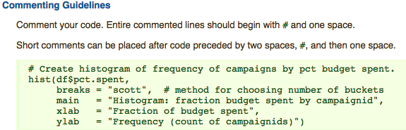
R Style Guide
We will be using the Google R Style Guide for this course: https://google.github.io/styleguide/Rguide.xml#comments
Note the following passage on commenting as all graded code will require comments so I know what your code is supposed to accomplish.

Slide 8
Basic Concepts of Shiny apps
Section 1

Slide 9
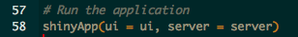
Two Basic Parts of the function
UI – User Interface
Builds the webpage
Can be done in R code OR HTML
Server
Generates all reactive content
Can be used to change portions of UI

Slide 10
The User Interface
UI

Slide 11
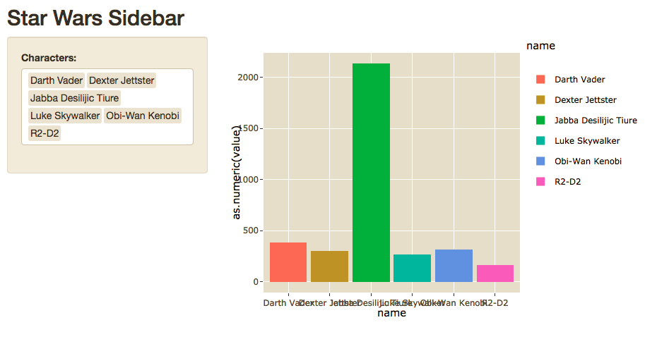
Sidebar Layout

Slide 12
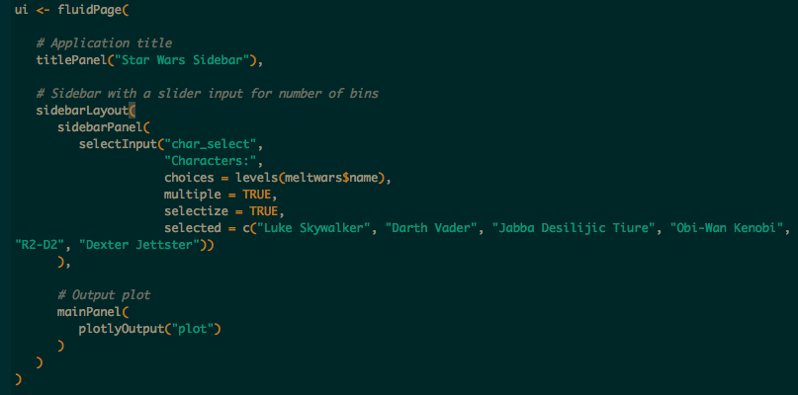

Slide 13
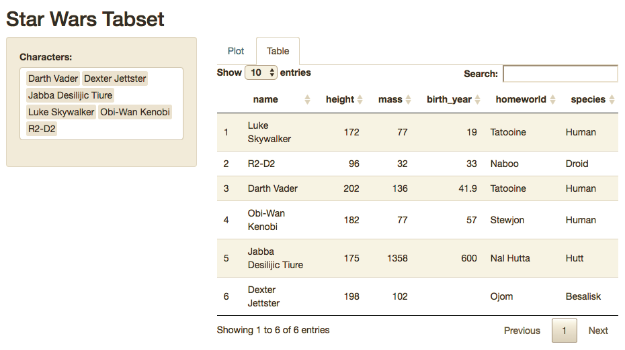
Sidebar w/ Tabset

Slide 14
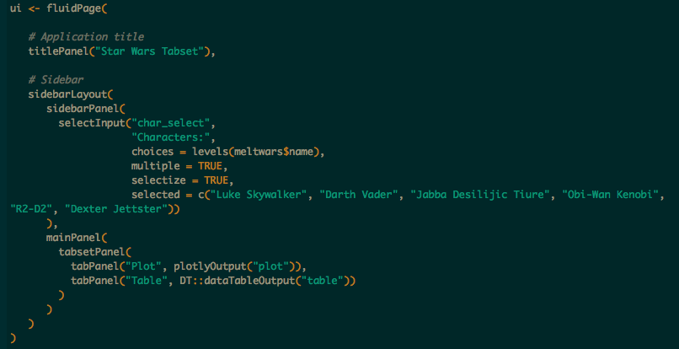

Slide 15
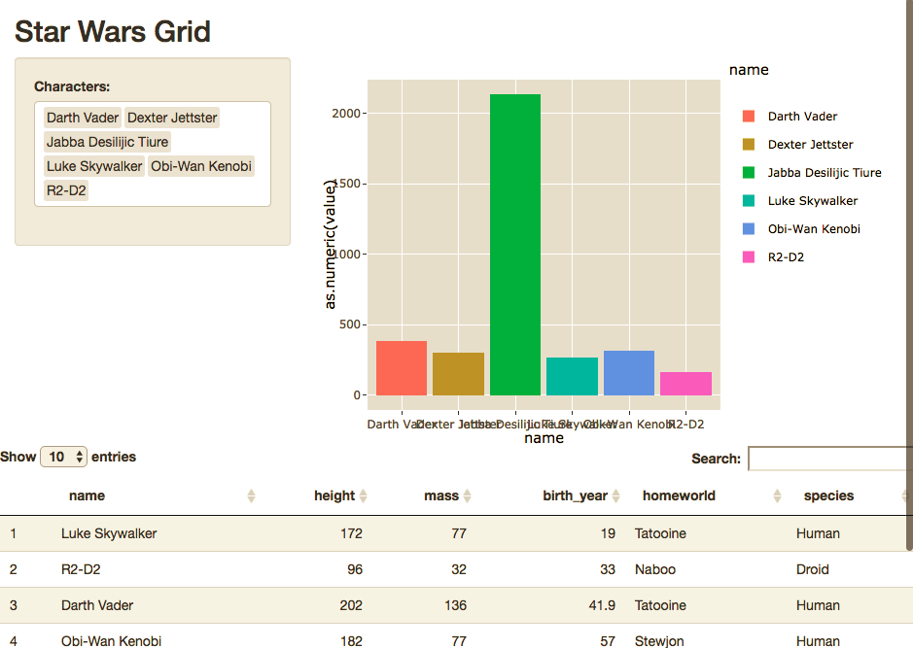
Grid

Slide 16
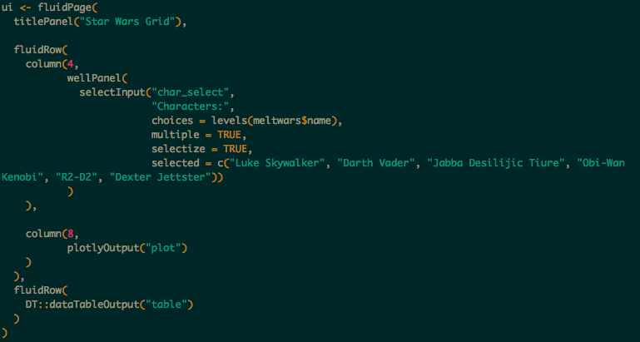

Slide 17
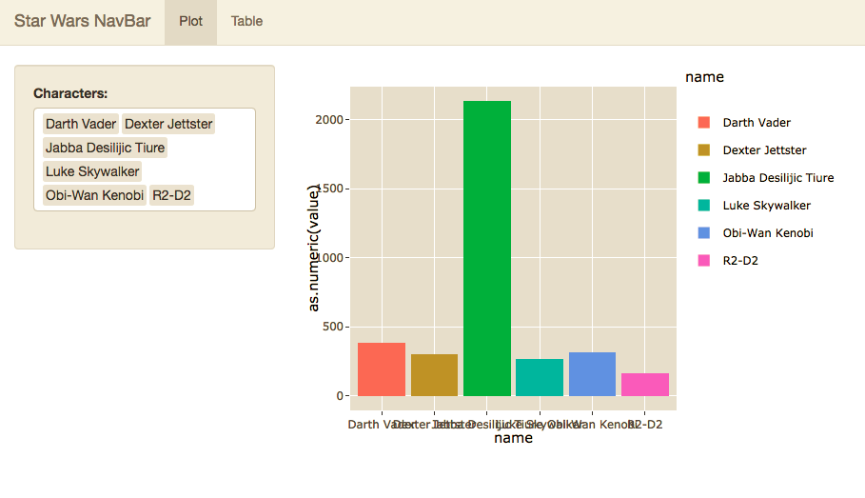
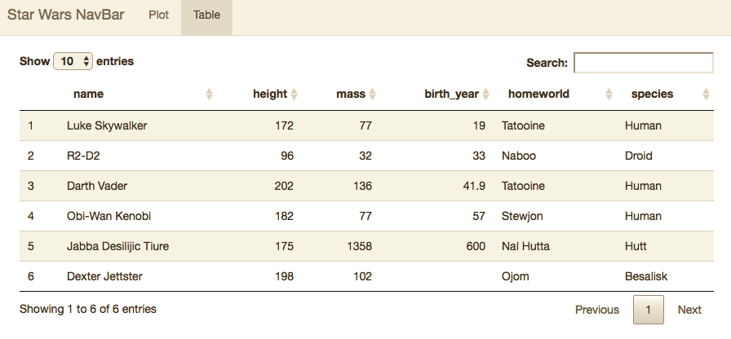
NavBar

Slide 18
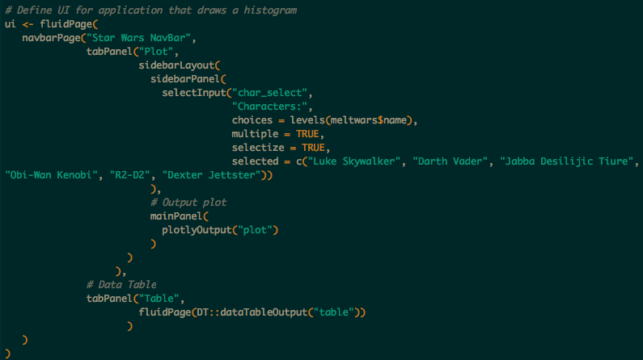

Slide 19
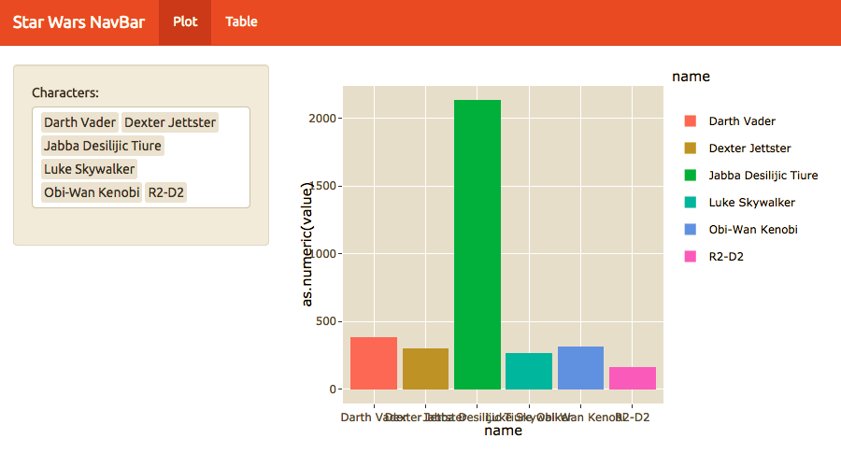
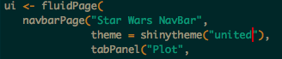
Custom Theme

Slide 20
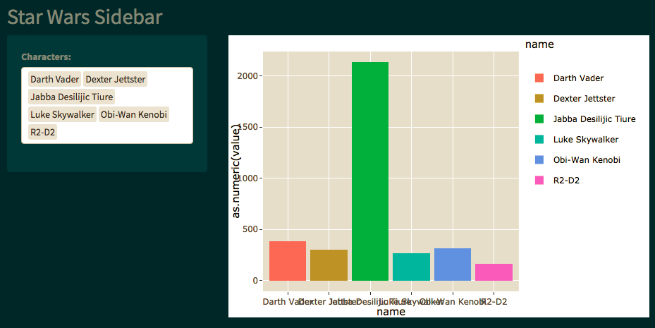
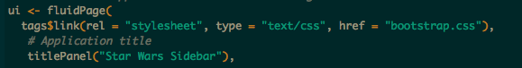
Custom Themes

Slide 21
The Server Function
server

Slide 22
Introduction to Server Function
Outputs
List of functions called in the UI which generates plots, tables and other objects.
Will regenerate whenever dependent inputs are changed, or based off of required action in UI.
Shiny Apps will display from any graphics package including;
ggplot2
plotly
DT
LeafletR
ggvis
googleVis
wordcloud2
d3heatmap
dygraphs
ggmap
highcharter
rgl
DiagrammeR
rCharts

Slide 23
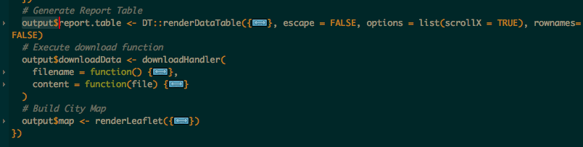
Saving Outputs
Output is a list which you build onto as you create your visuals
Each entry in the list is called in the UI by the name saved.
Example:
The three outputs below are called by “report.table”, “downloadData” and “map” respectively.
Otherwise these images work just like anything created in an RMarkdown document

Slide 24
Section 1 REVIEW
Shiny Apps are made of up of three arguments.
Ui
Server
There are numerous layout selections and combinations
To easily style your map you can use custom or free css bootstraps
Outputs are functions which generate the desired content for the app’s UI
GitHub is not the only versioning thing out there, but it’s the one our Professor is making us it.

Slide 25
Practice

Slide 26
Shiny Dashboards
Section 3

Slide 27
Basic Layout
Dashboards are broken into a single argument made up of three arguments
Header – Window title as well as Menus
Sidebar – Sidebar for navigating Dashboard tabs and can hold global selection inputs
Body – Where the magic happens.

Slide 28
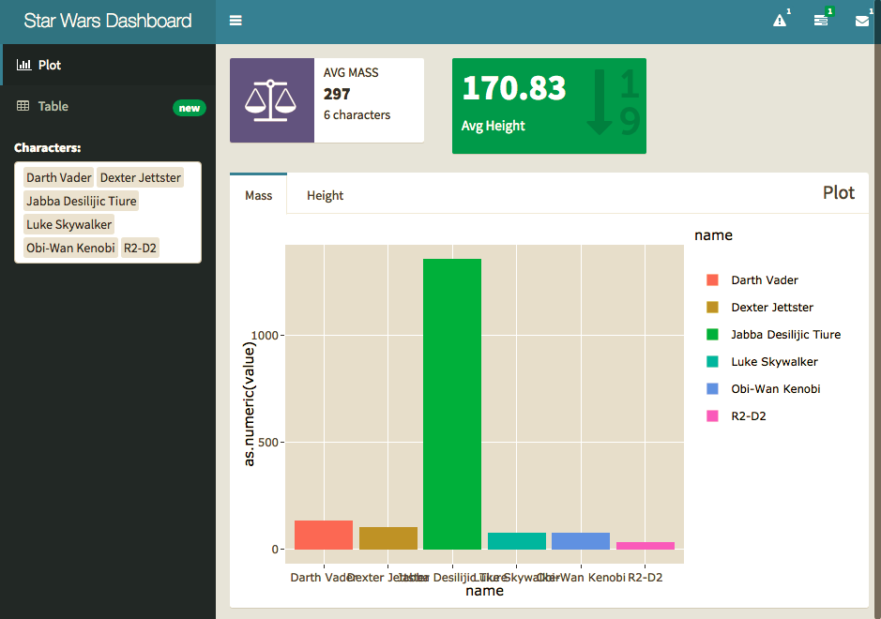

Slide 29
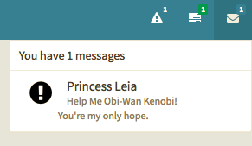
Headers

Slide 30
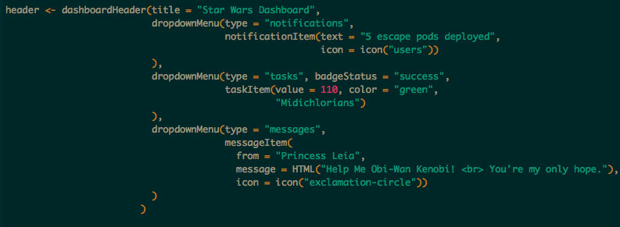
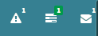
Options
Notifications
Tasks
Messages

Slide 31
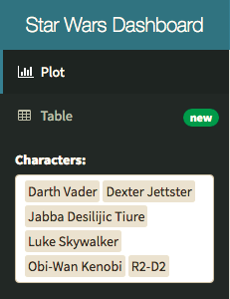
Sidebar

Slide 32
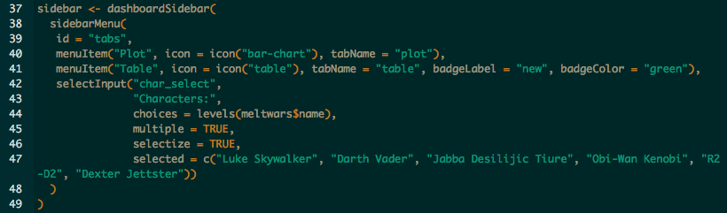
Menu Items – tabName referenced in body.
Global Inputs – Should work on all tabs and for all visuals.

Slide 33
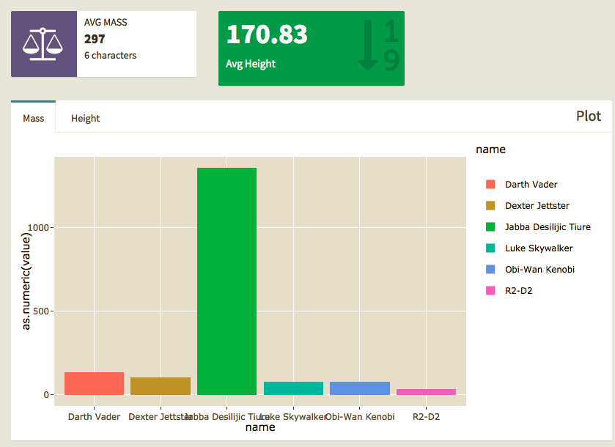
Body

Slide 34
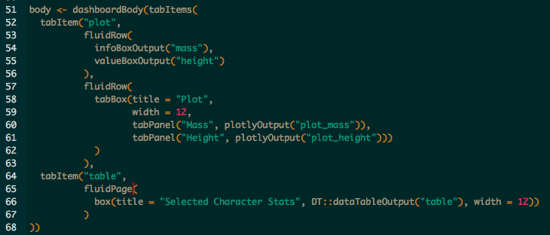
Tab Items – by name in Menu
Row\Page – based layouts
Box – All contents should go in a box
Page is broken into 12 equal bars. Width can be 1-12
If 12+ is specified content will kick to new row automatically, anything unspecified will get squished.
Inputs – can also go in boxes here should be clear what visuals they work with.

Slide 35
Practice

Slide 36
Break

Slide 37
Widgets & Reactivity
https://shiny.rstudio.com/gallery/widget-gallery.html
Section 3

Slide 38
How do Input Widgets Work?
Inputs are sent to the server function as a list.
Each are called by input$“inputId”
Value and length of the input depends on the widget
Inputs can even be entire files, images, urls etc.

Slide 39
Numeric Inputs

Slide 40
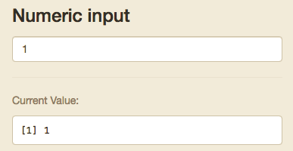
Numeric Input
Goes up and down based off clicks
Stored as single numeric input

Slide 41
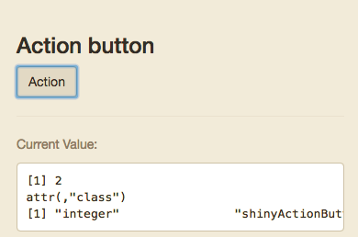
Action Button
+1 each time it is clicked
Stored as single numeric input

Slide 42
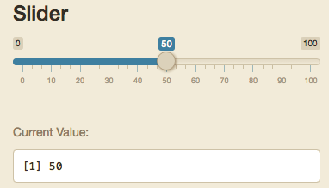
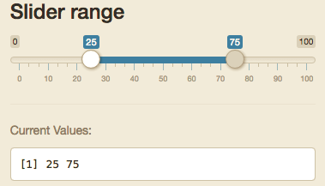
Slider/Range
Either a single integer or list of 2 called separately by input$“inputId”[1] and input$“inputId”[2]

Slide 43
Text Inputs

Slide 44
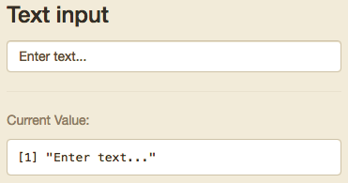
Text Input
Can be tied to action button or enter to initialize input.

Slide 45
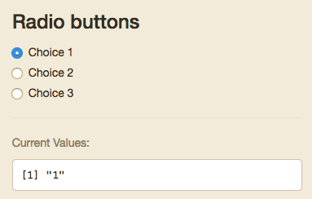
Radio Buttons
Only one option
Value can be dictated in your code, but will default to the value of the text in the choices field

Slide 46
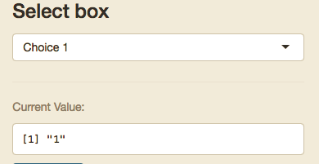
Select input
Can be set to only one selected option or multiple
Value can be dictated in your code, but will default to the value of the text in the choices field
Stored either as a single object or as a list

Slide 47
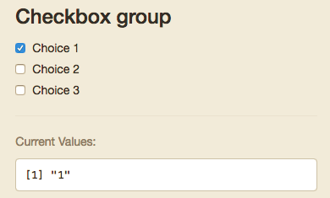
Checkbox Group
Multiple can be selected
Value can be dictated in your code, but will default to the value of the text in the choices field
Stored either as a single object or as a list

Slide 48
Other Inputs

Slide 49
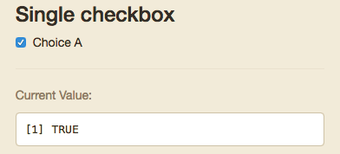
Single Checkbox
Boolean

Slide 50
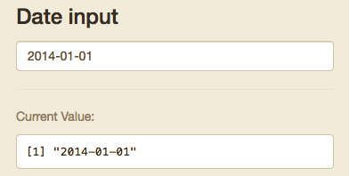
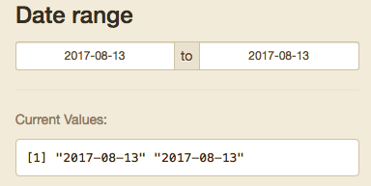
Date/Range
Either a single integer or list of 2 called separately by input$“inputId”[1] and input$“inputId”[2]
R will see these as Dates

Slide 51
Single Checkbox
Boolean

Slide 52
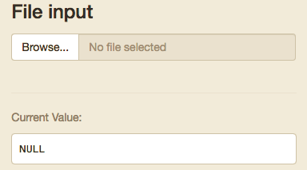
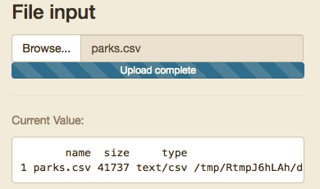
File Input
You should make sure your code checks the format and end of the file

Slide 53
Output Based Inputs

Slide 54
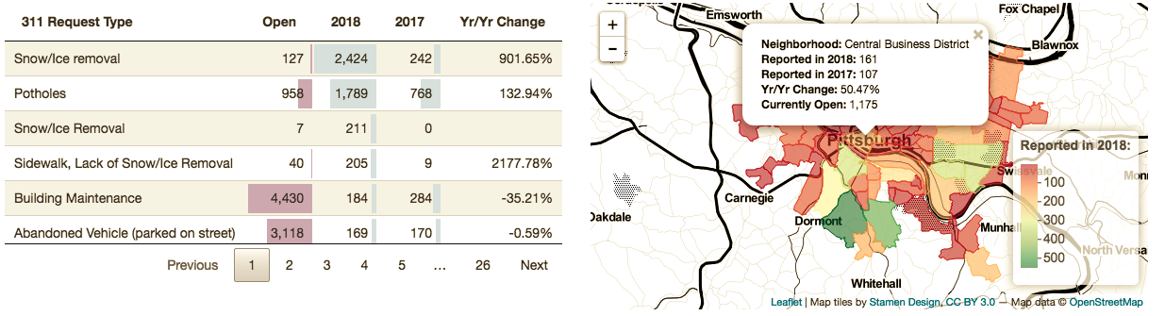
Data Table
The DT::datatable outputs has many inputs you can use to control other plots or outputs.
Before

Slide 55
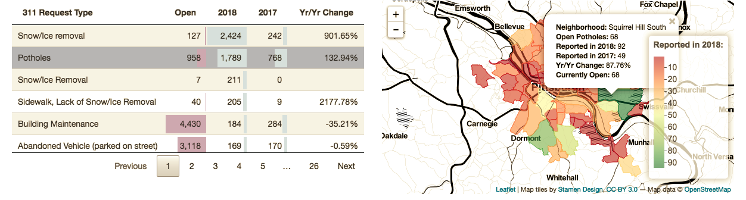
Data Table
The DT::datatable outputs has many inputs you can use to control other plots or outputs.
After

Slide 56
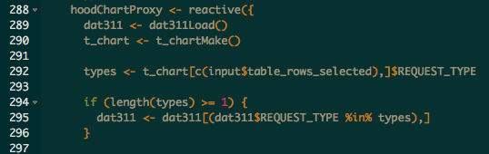
Data Table
The DT::datatable outputs has many inputs you can use to control other plots or outputs.

Slide 57
reactive

Slide 58
Everything in R is a Function
Reactive Datasets are a functions you can call whenever you need a set of actions to occur based off of filters in your application
They should be used whenever you are using the same inputs/filters on the same data for multiple outputs/visuals.
You can call reactive functions within other reactive functions for simple
These go in the server function/files
They are called as any function but with no arguments
Caches results to speed up loading
Ensures your visuals are all showing the same information
Shorter more legible code

Slide 59
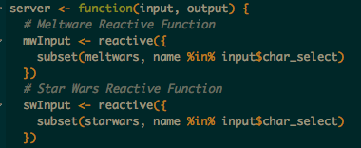
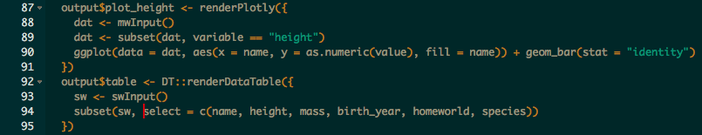
Reactive Example
Using our Shiny Dashboard from last week we have a bunch of plots and info boxes using the same data and filters.
If we add reactive functions we can call the filtered data automatically in each output.

Slide 60
Practice

Slide 61
Updates inputs and more
Section 4

Slide 62
Updates

Slide 63
Updates & Observe Events
Any time you wish to update part of your UI you will need to include an event observer.
Here you will be observing an input that your user can interact with
Observers can be done in one of two ways. Event observers or generic observer function
observeEvent() when you are observing a particular input
observe() works if you want to observe multiple things, or non-input based object such as the output or content of a reactive function.

Slide 64
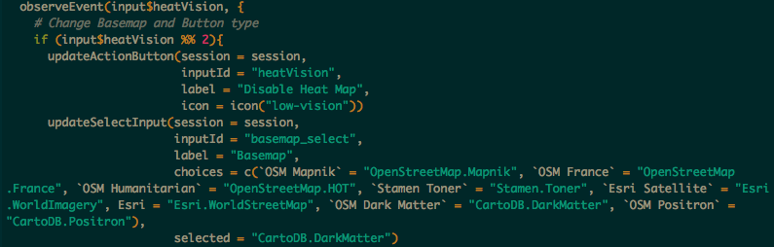
Event Observer Example
Here we will look at how I use this in the Burgh’s Eye View

Slide 65
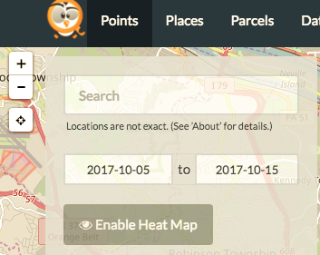
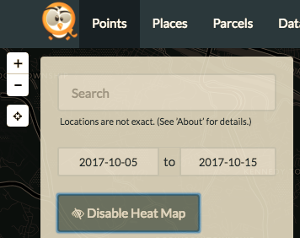
Before: After:

Slide 66
Notifications

Slide 67
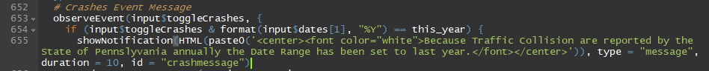
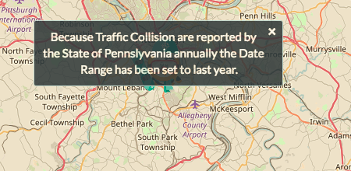
Notification Example

Slide 68
Bookmarking

Slide 69
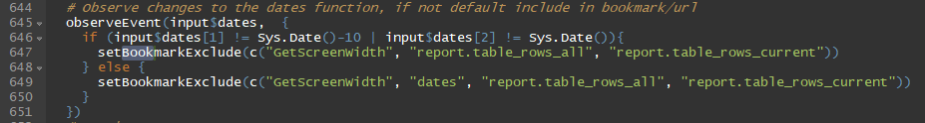
Bookmarking Example

Slide 70
Progress Bars

Slide 71
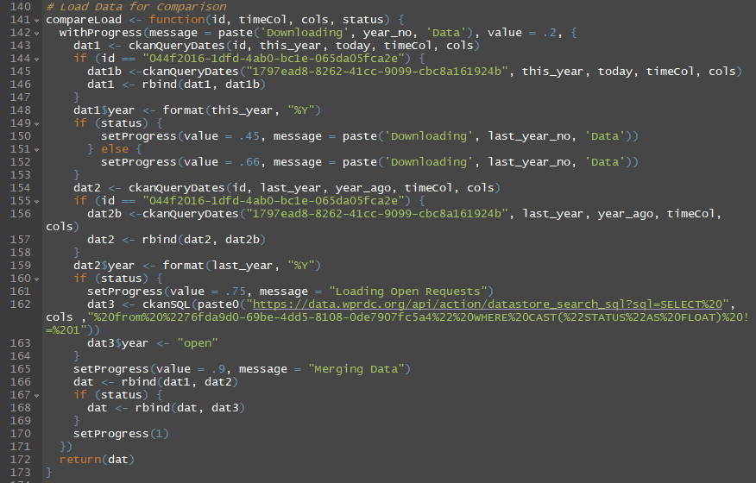
Progress Bar Example

Slide 72
Practice

Slide 73
Break

Slide 74
Shiny & Rmarkdown
Section 5

Slide 75
Flexdashboard

Slide 76
FlexDashboard
All code is handled within the Markdown Style
You can embed standalone shiny apps, or use elements from the dashboard at large.
More structured than shiny apps, but…
It’s easier
Looks nicer

Slide 77
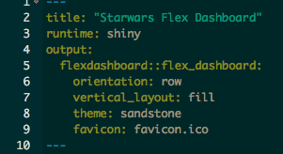
Setup
Other options
Logo
NavBar Icons
Embed Code
Sharing Links
Custom CSS file

Slide 78

Global Sidebar

Slide 79

Page Sidebar

Slide 80

Value Box

Slide 81

Plot

Slide 82

Data Table

Slide 83
Shiny Apps.io
http://www.shinyapps.io/
Section 6

Slide 84


Register a free Account

Slide 85


Connect your account

Slide 86

Publish todays app

Slide 87


